Slide 1
Trading
Systems

Slide 2
DISCLOSURE
This course is not designed to recommend any specific trading strategy, instead it is here to help understand the complexities and challenges of building a trading system. Any trading system you develop will have risk associated with it, whether it’s from mechanical failure or volatile markets. It’s important that you adequately test any trading system you develop, only trade with money you can lose, and understand the skillset required to build and manage a trading system. Additionally, the code in this tutorial must be adapted to your own unique trading strategy and should never assume that the code will work as is. Packages often have updates made to them and may work differently on different systems. Please make sure to thoroughly read any documentation before using the packages in this tutorial.

Slide 3
What is a Trading System?
Overview:
Automated trading systems — also referred to as mechanical trading systems, algorithmic trading, automated trading or system trading — allow traders to establish specific rules for both trade entries and exits that, once programmed, can be automatically executed via a computer. In fact, various platforms report 70% to 80% or more of shares traded on U.S. stock exchanges come from automatic trading systems.
Resource Link:
What is a Trading System | Investopedia

Slide 4
Pros & Cons of Trading Systems
Pros | Cons
Minimizes Emotion: Automated trading systems minimize emotions throughout the trading process. By keeping emotions in check, traders typically have an easier time sticking to the plan. | Mechanical failures can happen: The theory behind automated trading makes it seem simple: Set up the software, program the rules and watch it trade. Automated trading is a sophisticated method of trading, yet not infallible.
Back testing: Back testing applies trading rules to historical market data to determine the viability of the idea. | Over-Optimization: Although it would be great to turn on the computer and leave for the day, automated trading systems do require monitoring. This is because of the potential for technology failures, such as connectivity issues, power losses or computer crashes, and to system quirks.
Preserving Discipline: Because trade rules are established and trade execution is performed automatically, discipline is preserved even in volatile markets. Discipline is often lost due to emotional factors such as fear of taking a loss, or the desire to eke out a little more profit from a trade. | Monitoring: Though not specific to automated trading systems, traders who employ back testing techniques can create systems that look great on paper and perform terribly in a live market. Over-optimization refers to excessive curve-fitting that produces a trading plan unreliable in live trading.
Improving Order Entry Speed: Since computers respond immediately to changing market conditions, automated systems can generate orders as soon as trade criteria are met. Getting in or out of a trade a few seconds earlier can make a big difference in the trade's outcome.
Diversifying Trading: Automated trading systems permit the user to trade multiple accounts or various strategies at one time.
Resource Link:
What is a Trading System | Investopedia

Slide 5





Project Overview
Our goal is to create a full fledge trading system that harvests data from different financial sources, cleans and stores the harvested data, leverages a machine learning model to generate signals, process and submit orders to our broker, and provide a simple user interface to manage our system.
Future-Ready
To collect, clean, and store our data we will leverage Azure Data Factories to manage, create, and connect multiple data sources.
Build on Your Terms
With Azure Machine Learning, we will define, manage, and put into production or machine learning model that will help us identify entry points for our trades.
Operate Hybrid Seamlessly
Azure functions provide a lightweight framework that can help us build customizable bite-size portions of code that can help us manage different aspects of our system.
Trust Your Cloud
To access our trading system from any platform we will host it on Azure using the Web App Service. Additionally, this will enable us to create a simple user interface to interact and manage our trading system.

Slide 6
Defining a Framework – Trading System:
Strategy 1
Trading System
Strategy 2
Strategy 3

Slide 7
Defining a Framework - Strategies:
Trigger
1
Open
2
Strategy
Manage
3
Close
4

Slide 8
Defining a Framework - Trigger:
Condition 1
On Event
Situation 1
Condition n
Situation n
Defining Position
Trigger
Condition 1
Take Position
Situation 1
Condition n
Situation n
Condition 1
Off Event
Situation 1
Condition n
Situation n

Slide 9
Defining a Framework - Open:
Ex. Profit Margin
Take Profit
Formula
Ex. Capital Invested
Ex. Risk Tolerance
Initial Stop
Formula
Open
Ex. Market Volatility
Opening Exec.

Slide 10
Defining a Framework - Manage:
Ex. 10 mins away
Time
Formula
Take Profit
Phase 1
Manage
Phase n
Stop Loss
Phase 1
Phase n

Slide 11
Defining a Framework - Close:
Closing Execution
Close
Record Keeping

Slide 12
Yes, it can get complicated…
Situation 1
Condition 1
On Event
Condition n
Situation n
Defining Position
Trigger
Situation 1
Condition 1
Take Position
Condition n
Situation n
Condition 1
Off Event
Situation 1
Condition n
Trigger
Situation n
Open
Take Profit
Formula
Strategy
Strategy 1
Manage
Initial Stop
Open
Formula
Trading System
Strategy 2
Close
Opening Exec.
Strategy 3
Formula
Time
Take Profit
Phase 1
Manage
Phase n
Stop Loss
Phase 1
Phase n
Closing Execution
Close
Record Keeping

Slide 13
What is Azure Data Factory?
Overview:
Microsoft Azure Data Factory is a cloud-based data integration service that allows you to create data-driven workflows to orchestrate and automate the extraction, movement and transformation of data. The Azure Data Factory helps simplify and automate the ETL (Extract Transform & Load) process that many companies depend on to do their different types of analysis. One major benefit of the Azure Data Factory is that it has over 90+ different data connectors that can help you integrate data from a wide variety of sources at no additional cost to the user.
Resource Link:
Data Factory - Data Integration Service | Microsoft Azure

Slide 14

Azure Data Factory Components
Pipelines | Activities | Datasets | Linked Services
A data factory can have one or more pipelines. A pipeline is just a container for activities. | A pipeline can have one or more activities. Activities are definitions of what actions to perform on your data, e.g., using the copy activity to move data from one data store to another data store. Activities can also be configured to run conditionally, such as on failure or on success, etc. | Activities take zero or more datasets as inputs and one or more datasets as outputs. Datasets are representative structures of data within datastores. | You can think of these as being like connection strings, they define the connection needed to connect to external resources outside of Azure Data Factory.
Resource Link:
Data Factory - Data Integration Service | Microsoft Azure

Slide 15
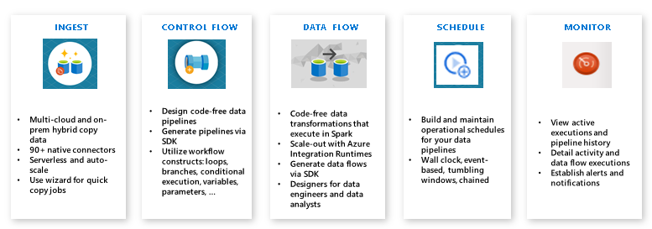
ETL As A Service
Resource Link:
Data Factory - Data Integration Service | Microsoft Azure

Slide 16
How we use the Azure Data Factory
Overview:
The financial industry is known for its large data sources that stretch back many decades in the forms of filings or even price data. Collecting, cleaning and transforming this data is an impossible task without some form of automation that can help optimize and standardize the process. We will use Azure Data Factories to help collect data from the SEC and different APIs containing a wide variety of real time and historical trading data.
Additionally, we will use these factories to help clean and standardize the data so we can effectively analyze and leverage it in our trading strategy.

Slide 17
Microsoft Azure
Azure SQL

Slide 18

What is Azure SQL?
Overview:
The family of SQL cloud databases providing flexible options for application migration, modernization, and development. With Azure SQL you get a consistent, unified experience across your entire SQL portfolio and a full range of deployment options from edge to cloud.
Resource Link:
Azure SQL | Microsoft Azure

Slide 19


Azure SQL Database
SQL Server on Azure VM | Azure SQL Managed Instance | Azure SQL Database
Migrate your SQL workloads to Azure with ease while maintaining complete SQL Server compatibility and operating system-level access. | Modernize your existing SQL Server applications at scale with an intelligent, fully managed service. | Support modern cloud applications on an intelligent, fully managed service that includes serverless compute.
Resource Link:
Azure SQL | Microsoft Azure

Slide 20
Azure SQL Database Pricing
Component | Description
Service Tiers | Service tier options in the vCore model include General Purpose, Business Critical, and Hyperscale. The service tier generally defines the storage architecture, space and I/O limits, and business continuity options related to availability and disaster recovery.
Compute tiers | The SQL Database provisioned compute tier provides a fixed amount of compute resource for a fixed price billed hourly. The SQL Database serverless compute tier optimizes price-performance and simplifies performance management for single databases with intermittent, unpredictable usage by auto-scaling compute and billing for compute used per second.
Hardware | Hardware generation options in the vCore model include Gen 4/5, M-series, and Fsv2-series. The hardware generation generally defines the compute and memory limits and other characteristics that impact the performance of the workload.
Deployment Model | Single database represents a fully managed, isolated database. You might use this option if you have modern cloud applications and microservices that need a single reliable data source. A single database is like a contained database in the SQL Server database engine. Elastic pool is a collection of single databases with a shared set of resources, such as CPU or memory. Single databases can be moved into and out of an elastic pool.
Storage | The amount of storage you want for your SQL Database Instance.
Back Up Storage | Storage used to either keep data for compliance reasons (Long-Term Retention) or to restore a database (Point-in-time restore).
Resource Link:
Azure SQL Pricing | Microsoft Azure

Slide 21
Azure SQL Database Hardware
Hardware generation | Compute | Memory
Gen4 | Intel® E5-2673 v3 (Haswell) 2.4 GHz processors Provision up to 24 vCores (1 vCore = 1 physical core) | 7 GB per vCore Provision up to 168 GB
Gen5 | Provisioned compute: Intel® E5-2673 v4 (Broadwell) 2.3-GHz, Intel® SP-8160 (Skylake)*, and Intel® 8272CL (Cascade Lake) 2.5 GHz* processors. Provision up to 80 vCores (1 vCore = 1 hyper-thread) Serverless compute: Intel® E5-2673 v4 (Broadwell) 2.3-GHz and Intel® SP-8160 (Skylake)* processors Auto-scale up to 40 vCores (1 vCore = 1 hyper-thread) | Provisioned compute: 5.1 GB per vCore Provision up to 408 GB Serverless compute: Auto-scale up to 24 GB per vCore Auto-scale up to 120 GB max
Fsv2-series | Intel® 8168 (Skylake) processors Featuring a sustained all core turbo clock speed of 3.4 GHz and a maximum single core turbo clock speed of 3.7 GHz. Provision up to 72 vCores (1 vCore = 1 hyper-thread) | 1.9 GB per vCore Provision up to 136 GB
M-series | Intel® E7-8890 v3 2.5 GHz and Intel® 8280M 2.7 GHz (Cascade Lake) processors Provision up to 128 vCores (1 vCore = 1 hyper-thread) | 29 GB per vCore Provision up to 3.7 TB
Resource Link:
Azure SQL Hardware | Microsoft Azure

Slide 22



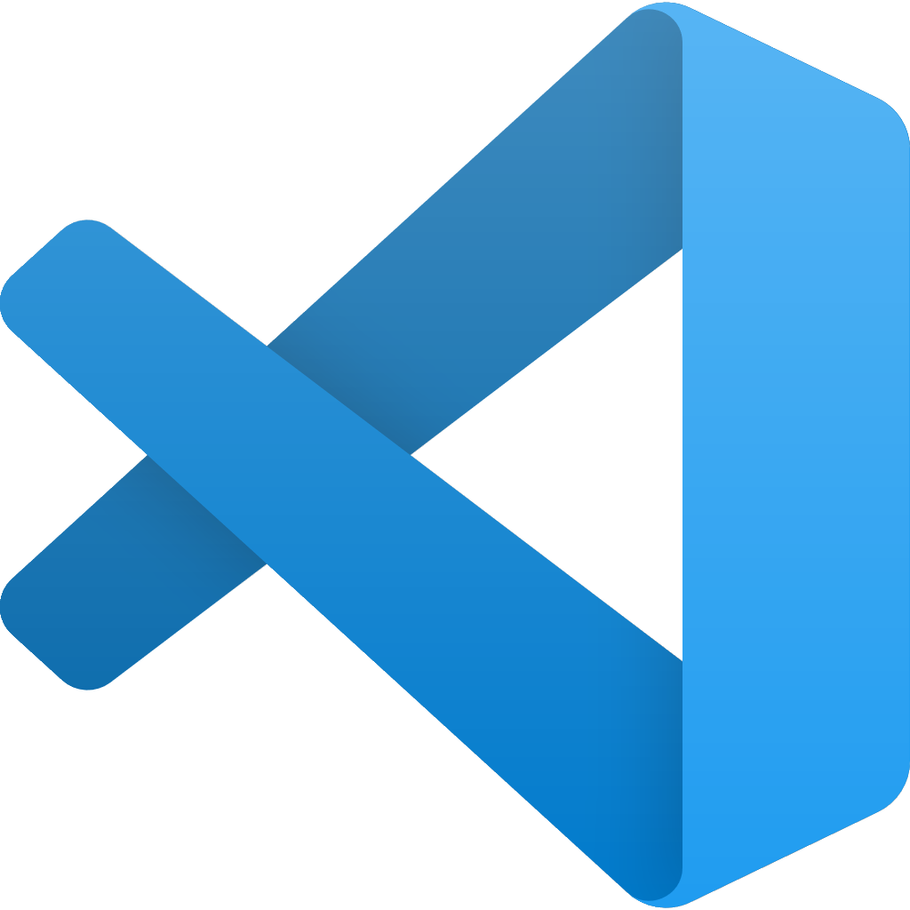

Tools & Packages:
Tool |  | Description
Azure Data Studio |  | A light-weight editor that can run on-demand SQL queries, view and save results as text, JSON, or Excel. Edit data, organize your favorite database connections, and browse database objects in a familiar object browsing experience.
SQL Server Management Studio (SSMS) |  | Manage a SQL Server instance or database with full GUI support. Access, configure, manage, administer, and develop all components of SQL Server, Azure SQL Database, and SQL Data Warehouse. Provides a single comprehensive utility that combines a broad group of graphical tools with several rich script editors to provide access to SQL for developers and database administrators of all skill levels.
SQL Server Data Tools (SSDT) |  | A modern development tool for building SQL Server relational databases, Azure SQL databases, Analysis Services (AS) data models, Integration Services (IS) packages, and Reporting Services (RS) reports. With SSDT, you can design and deploy any SQL Server content type with the same ease as you would develop an application in Visual Studio.
Visual Studio Code |  | The mssql extension for Visual Studio Code is the official SQL Server extension that supports connections to SQL Server and rich editing experience for T-SQL in Visual Studio Code. Write T-SQL scripts in a light-weight editor.
PYODBC |  | PYODBC is an open source Python module that makes accessing ODBC databases simple. It implements the DB API 2.0 specification but is packed with even more Pythonic convenience.
azure-mgmt-sql |  | This is the Microsoft Azure SQL Management Client Library. This package has been tested with Python 2.7, 3.5, 3.6, 3.7 and 3.8.

Slide 23

What is Azure NoSQL?
Overview:
NoSQL databases are interchangeably referred to as “nonrelational,” “NoSQL DBs,” or “non-SQL” to highlight the fact that they can handle huge volumes of rapidly changing, unstructured data in different ways than a relational (SQL) database with rows and tables. NoSQL technologies have been around since the 1960s, under various names, but are enjoying a surge in popularity as the data landscape shifts and developers need to adapt to handle the sheer volume and vast array of data generated from the cloud, mobile, social media, and big data.
Resource Link:
NoSQL Databases | Microsoft Azure

Slide 24



Types of NoSQL Databases
Key-Value | Document | Columnar | Graph
Key-value stores pair keys and values using a hash table. Key-value types are best when a key is known and the associated value for the key is unknown. | Document databases extend the concept of the key-value database by organizing entire documents into groups called collections. They support nested key-value pairs and allow queries on any attribute within a document. | Columnar, wide-column, or column-family databases efficiently store data and query across rows of sparse data and are advantageous when querying across specific columns in the database. | Graph databases use a model based on nodes and edges to represent interconnected data—such as relationships between people in a social network—and offer simplified storage and navigation through complex relationships.
Resource Link:
NoSQL Databases | Microsoft Azure

